Slide 1


.NET Microservices
Isaac Levin
Notes:
Welcome to .NET Workshop. In this overview session, I would like to set the stage for this workshop with the current landscape on how to build apps with .NET

Slide 2
Introduction to Docker

Slide 3
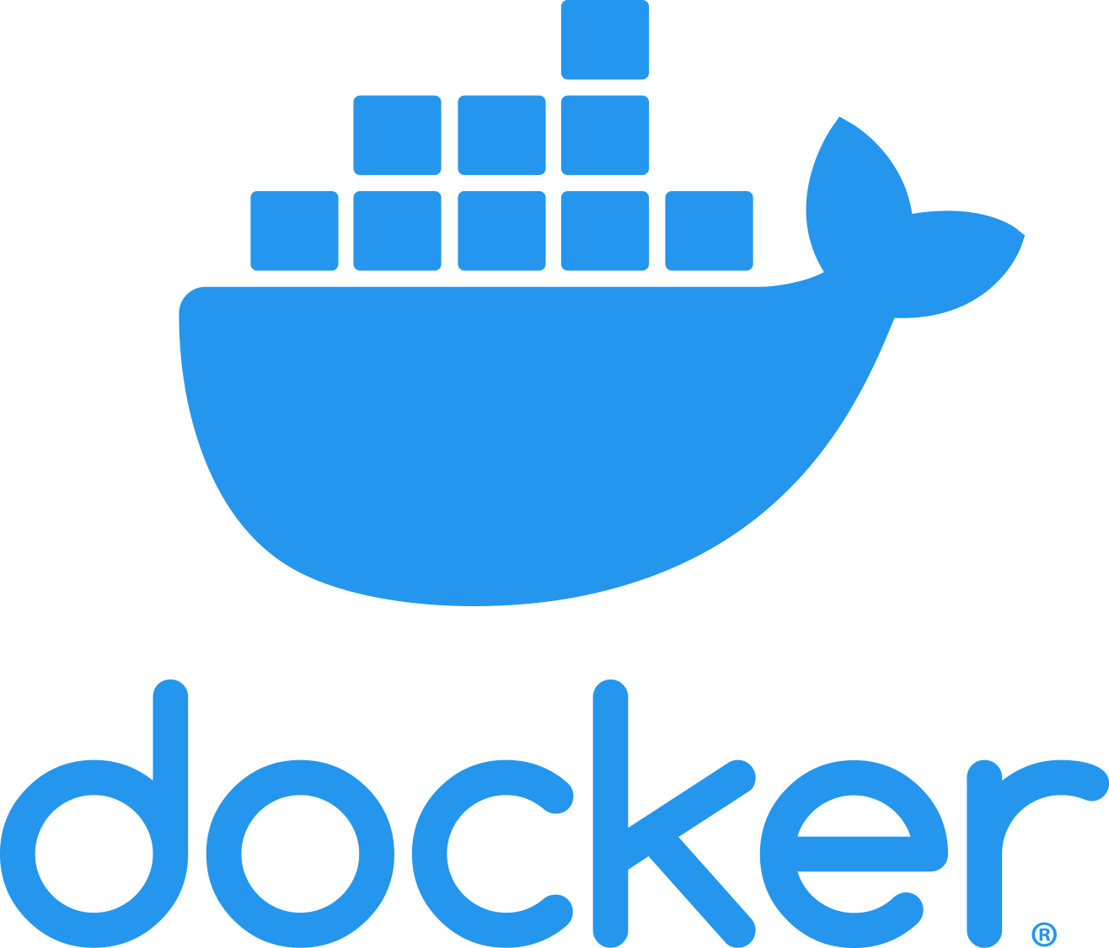

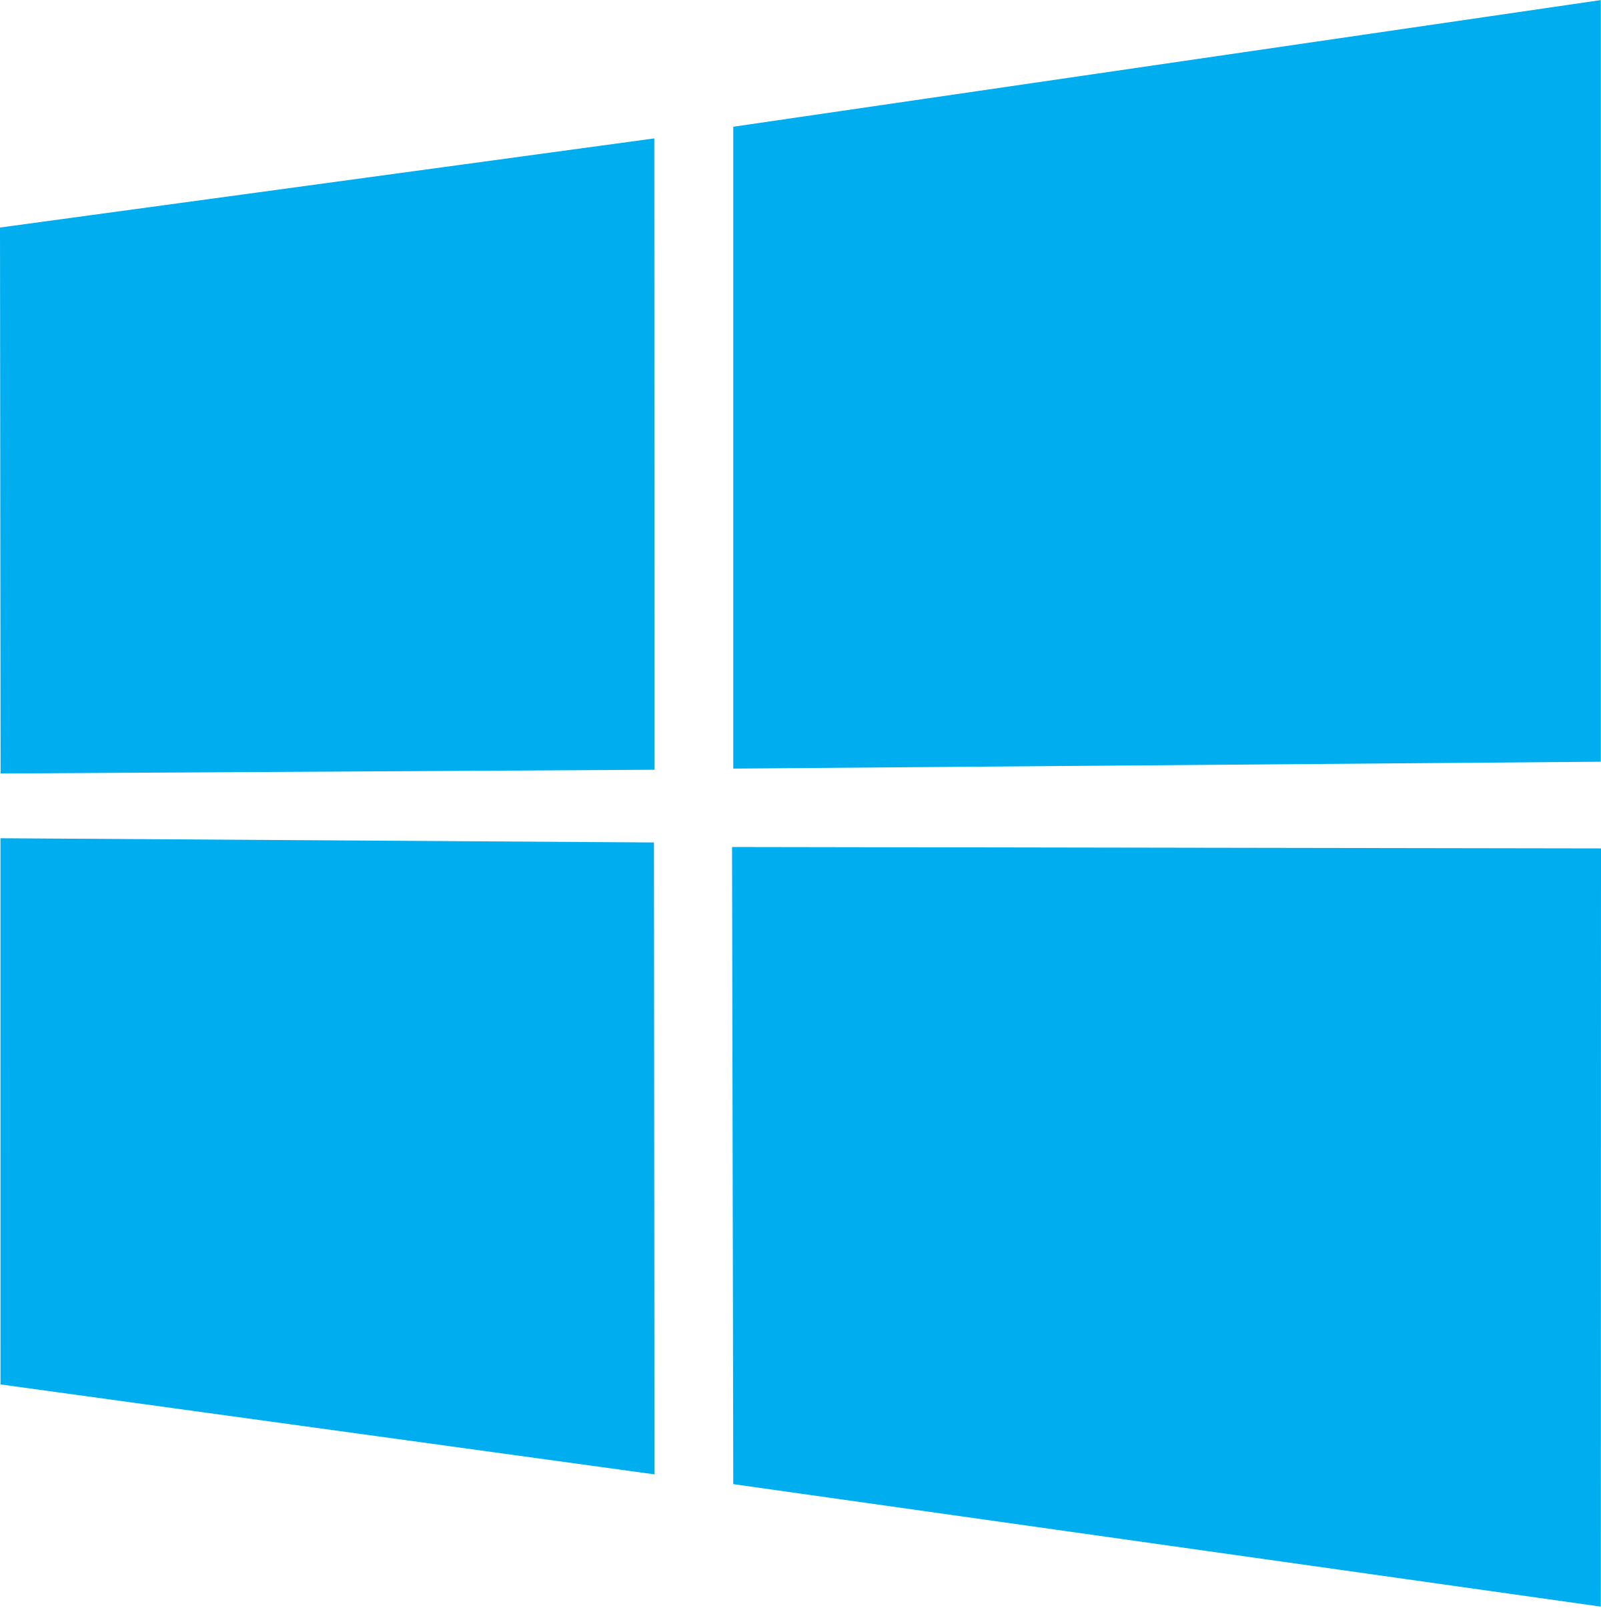
Docker Containers
Docker helps automating the deployment of applications as portable, self-sufficient containers that can run on any cloud or on-premises.
No more:
“It works in my dev machine!...
Why not in production?”
Now it is:
“If it works in Docker, it works in production”
Key words about WHY Docker?
Dependencies (self-sufficient)
Deployment
Notes:
Docker is also a company promoting and evolving this technology with a tight collaboration with cloud, Linux and Windows vendors, like Microsoft.

Slide 4



Virtual Machines
compared to
Docker Containers
App 1
App 2
App 3
Bins/Libs
Bins/Libs
Bins/Libs
Guest OS
Guest OS
Guest OS
App 1
App 2
App 3
Bins/Libs
Bins/Libs
Bins/Libs
Hypervisor
Container Engine
Host Operating System
Operating System
Infrastructure
Infrastructure
Notes:
Virtual Machines require significant resources for each application, since each VM runs a separate instance of the operating system.
Docker containers running on a single machine share that machine's operating system kernel; they start instantly and use less compute and RAM. Images are constructed from filesystem layers and share common files. This minimizes disk usage and image downloads are much faster.

Slide 5
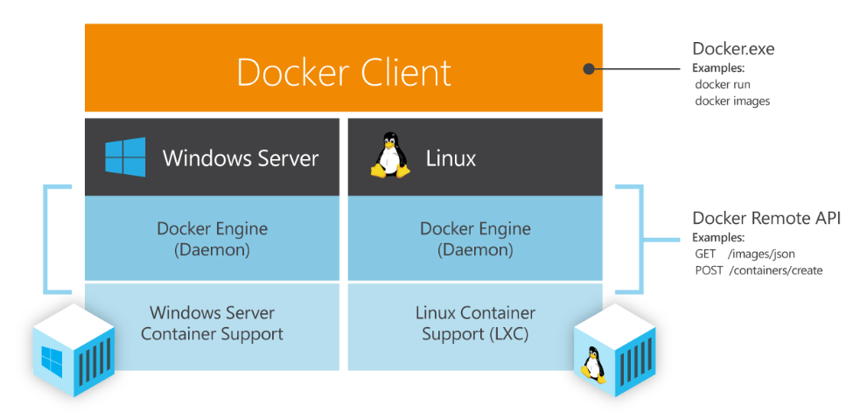
Docker Engine for Linux and Windows
Notes:
We’ve been making significant progress towards enabling multi-container, distributed applications in the past few months. Composing multi-Docker container applications will become significantly easier as we integrate Fig into Docker. We’ve also been making progress on other critical capabilities for orchestration including provisioning and managing Docker hosts, creating clusters of Docker hosts, and inter-Docker container networking, all of which will be previewed this quarter.
Microsoft’s endorsement and early work with our orchestration APIs is hugely exciting. Microsoft and Docker share a common vision that multi-container applications should be assembled using both Dockerized Windows and Dockerized Linux components. The two companies will work with emergent infrastructure tools for multi-container applications like Kubernetes, Mesos, Helios etc. to provide a uniform Docker interface that provides developers with multi-platform orchestration capabilities leveraging Dockerized content from these two ecosystems.

Slide 6
Running Containers on Windows
Windows Server Container
App
Windows Kernel
Notes:
Docker on Windows supports two models. The first is similar to standard Linux containers: the container runs on top of the kernel

Slide 7
Running Containers on Windows
Hyper-V Isolation
Virtual Machine Optimized for Containers
Windows Server Container
Windows Server Container
App
App
Windows Kernel
Windows Kernel
Hyper-V Hypervisor
Notes:
Windows Server also supports running Docker instances using Hyper-V Isolation, which gives increased security and isolation

Slide 8
Running Containers on Windows
Hyper-V Isolation
Hyper-V Isolation
Virtual Machine Optimized for Containers
Virtual Machine Optimized for
Containers
Windows Server Container
Windows Server Container
Linux
Container
App
App
App
Windows Kernel
Windows Kernel
Linux Kernel
Hyper-V Hypervisor
Hyper-V Hypervisor
Notes:
This support also runs with Hyper-V Isolation, running on individual Linux distributions or via LinuxKit

Slide 9
Docker and .NET

Slide 10

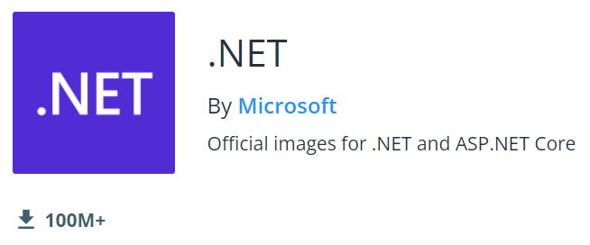
Docker and .NET
.NET 7 Docker images
xPlat. (Linux & Windows)
.NET Framework images
Windows only
See at Docker Hub

Slide 11
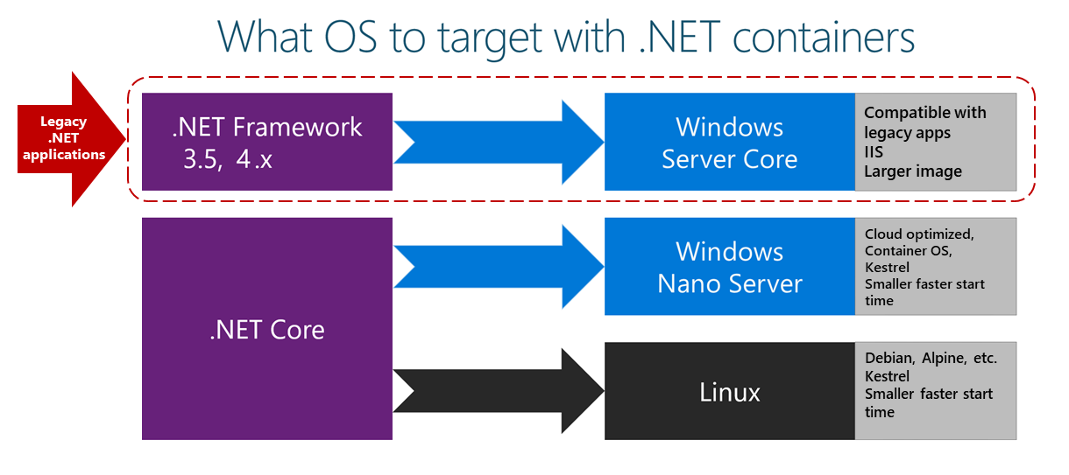
.NET 7

Slide 12
.NET Core Docker Images
sdk (760.76MB)
Contains tools and SDKs to build your applications
aspnet (211.74MB)
Optimized runtime image
Contains only what you need to run your ASP.NET Core application
runtime (189.95MB)
Optimized runtime image
Contains only what you need to run your ASP.NET Core application

Slide 13
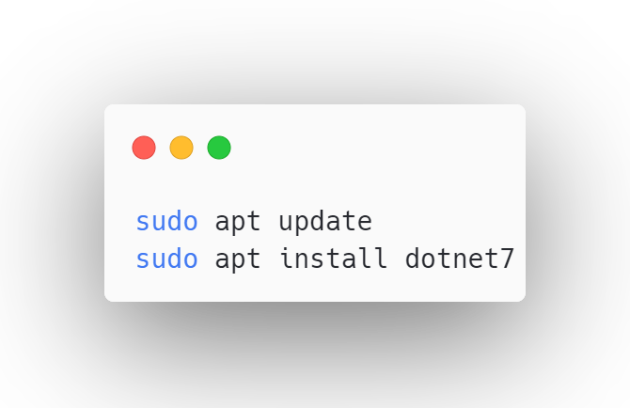
.NET in Ubuntu
.NET is in-box
Built by Canonical; help from Microsoft
Canonical enterprise-grade support
Same day updates for patches
x64 and Arm64 with .NET 6
.NET 7 coming soon

Slide 14
.NET in Ubuntu
.NET in Chiseled Ubuntu containers
Distroless images == Bare minimum
Quicker to pull/start
More secure – no shell
More secure – no package manager
More secure – non-root user
213 MB
-52%
104 MB

Slide 15
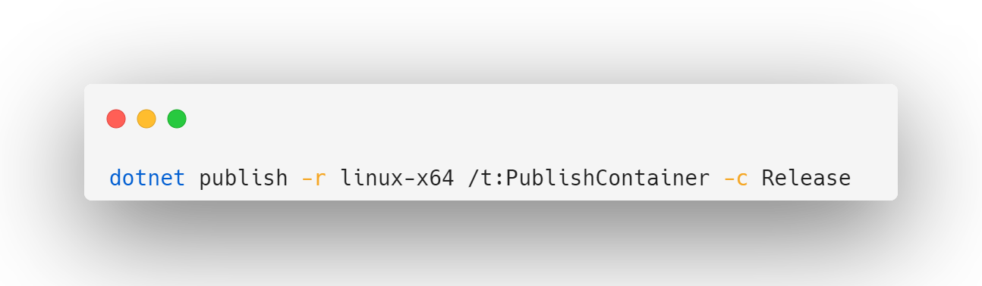
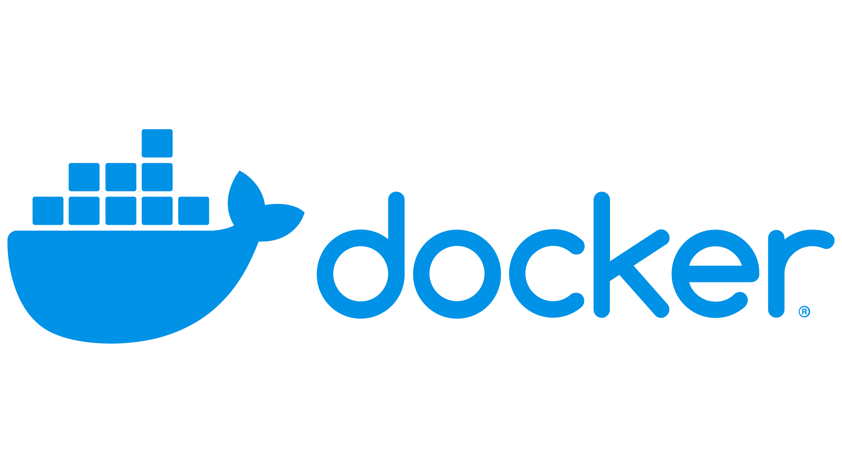


Built-in Container Support in .NET

Slide 16
Demo: .NET Core on Docker
https://docs.microsoft.com/en-us/aspnet/core/host-and-deploy/docker/building-net-docker-images

Slide 17
Demo: Visual Studio Docker Tools
https://docs.microsoft.com/en-us/aspnet/core/host-and-deploy/docker/building-net-docker-images

